Slide 1

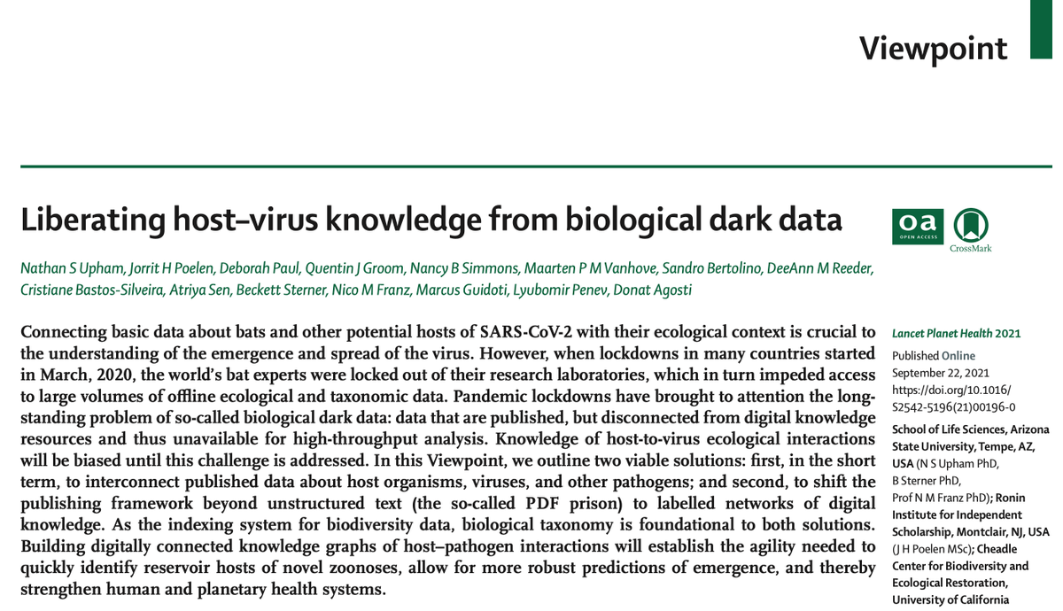
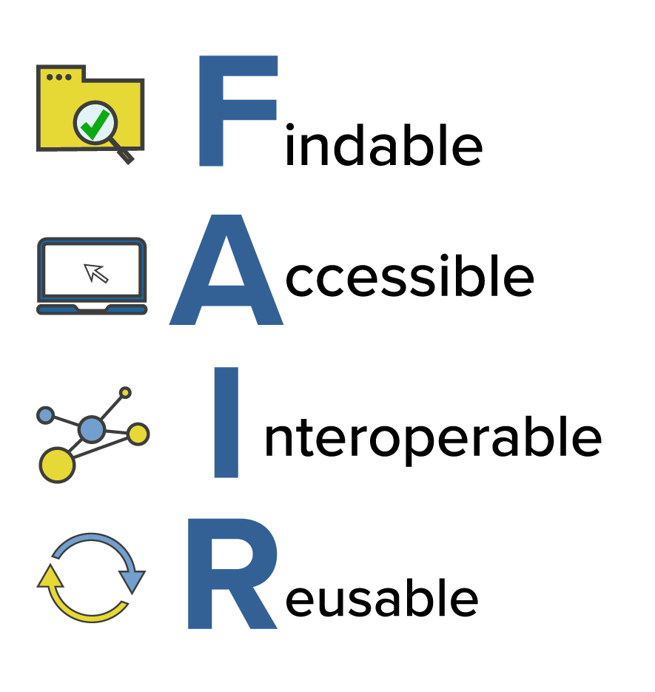
FAIR Data – extracted from publications
Notes:
…we followed open access and FAIR (Findable, Accessible, Interoperable, and Reusable) data principles for extracting data and choosing methodologies to liberate ecological knowledge from dark data.

Slide 2



Methods - Unattainable Literature
Notes:
Our gathering did not stop there. A significant amount of the articles we were interested in needed to be physically scanned, borrowed, or obtained through our affiliated libraries to get past paywalls. These obstacles are common and prevent many researchers’ access to information. Doing our part to make knowledge available to all…

